Slide 1

A Nominal Deep Learning Approach to Classifying Disease in Chest X-rays
By Zachary Seitz
CS505 – Introduction to Data Mining | Fall 2022
Southeast Missouri State University
Notes:
Hello everyone, My name is Zach and today I’ll be discussing the nominal deep learning approach I took to solve the problem of classifying diseases in chest x-rays.

Slide 2
Motivation
Improve patient outcomes
Free up medical professional time
Accessible screening/early detection
Deep learning could be very effective
Notes:
So the first question you might have is why? Not only why is this problem worth solving, but should we try to solve this problem with deep learning in particularr? The short is answer is the strong potential to improve patient outcomes. Together, heart disease and lung disease are the leading causes of death worldwide. Interestingly, Missouri is 10th in the nation in the most deaths due to chronic lower respiratory disease. These are diseases that tend to be very treatable, they tend to be preventable, especially with adequate early detection and screening programs, so really, the motivation is to help doctors do what they do and save as many lives as they can. So how can we do that? By using chest x-rays to detect disease as early as possible, and by used computer-assisted diagnostic tools to help doctors make those determinations. Additionally, if doctors are able to spend less time reading x-rays, they’re able to spend more time with other patients, which further increases patient outcomes, so the benefit we see is cyclical in nature.

Slide 3
Related Work
D. Shen et. al, 2017 describes uses in:
image registration/localization
anatomical/cell structures detection
tissue segmentation
computer-aided disease diagnosis/prognosis
“…the proposed model was able to achieve an accuracy of 98.857%, and further, a high F1 score of 99.002 and AUC score of 99.809 affirmed the efficacy of the proposed model.”
- M.F. Hashmi et. al., 2020
​
Notes:
But that sounds like a pipe dream, can it actually be done, right? Can we be so lofty as to save that we can use deep learning to save lives? Well, there’s certainly precedent for work in this area, and I want to highlight to interesting papers discussing the applications of deep learning in medicine, one of which highlights an important aspect of solving that problem.
IN 2020, Hashmi and their team used transfer learning to create a model capable of detecting pneumonia from chest x-rays. That team claimed to have very good results, they stated their model achieved over 98% accuracy and they claimed an AUC score of over 99. AUC is a commonly used classification metric: a score of 0.9 indicates a pretty good model, a score of 0.99 might indicate a little overfitting. That said, some researchers indicate using a well-trained classifier like AlexNet or GoogLeNet can attain an AUC score of 0.95 out of the box (see Related Work, Hashmi).
One important aspect highlighted by D. Shen et. al. is the extensive work required to create what they call handcrafted data sets, that is to say, datasets that are labeled by domain experts (so in this case radiologist or physicians). It creates datasets that are 1) labeled accurately and 2) emphasize the features that experts have deemed are important. However, it requires tremendous effort to create these data sets, especially in any meaningful quantity. In fact, the labels in the original dataset outlined in the next section were created using NLP, so there are important limitations to acknowledge regarding their accuracy, though the curators of the dataset maintain that they are over 90% accurate.
So deep learning has been used in all manner of medical uses and others have reported success using tranfers learning to address the same issues mentioned previously, so is it possible to train a model from scratch to accomplish the task? Next we’ll take a look at the set up of the experiment that asks that very question.

Slide 4
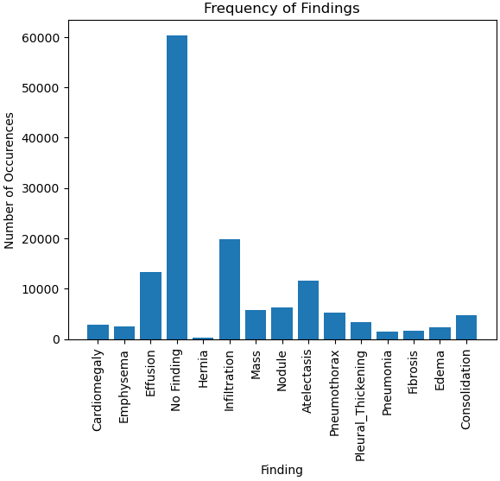
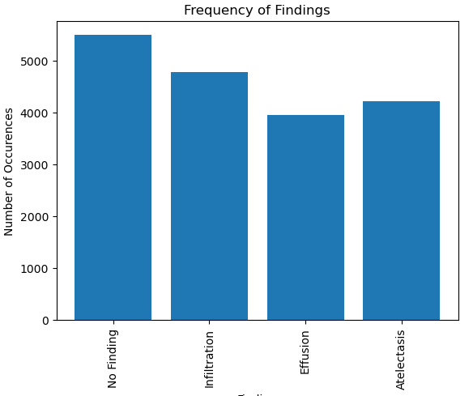
The data
Subset Dataset Graph
Notes:
The original dataset is very large. There are over 112K images for more than 31,000, each image is 1024 pixels square, there are 15 individual findings in over 800 unique combinations, it includes sex and age information for each patient, so it’s a lot to wrestle with. There were very distinct resource limitations, so the data had to be dramatically reduced in order for my machine to be able to handle it. Ultimately, only images with one finding and those categories with more than 3000 images were kept. I downsampled the no finding class and the infiltration class because in early tests, these classes represented the overwhelming majority of cases in the training sets. The results was a dataset with four classes of roughly equal size. Additionally, the images were reduced to 256 square pixels, primarily because of the previously mentioned resource limitations.

Slide 5
The model
Table 1. The experimental model architecture. All models were trained using this architecture with the notable exception of the ‘no dropout’ trial, in which only the dropout layers were removed.
Layer | Output Shape | Trainable Parameters
InputLayer | (256, 256, 3) | 0
Conv2D | (254, 254, 32) | 896
MaxPooling2D | (127, 127, 32) | 0
Dropout | (127, 127, 32) | 0
Conv2D | (125, 125, 64) | 18,496
MaxPooling2D | (62, 62, 64) | 0
Flatten | 246,016 | 0
Dense | 64 | 15,745,088
Dropout | 64 | 0
Dense | 32 | 2,080
Dense | 4 | 132
 | Total trainable parameters | 15,766,692
Notes:
Much like the pared down dataset, the model had to strike a balance between resource use and performance. The model had to be adequately complex so as to attempt to solve the problem at had, especially given the loss of detail cause by needing to shrink the images, but it had to be small enough to be able to run well enough with a reasonably sized data set. After many failed initial attempts, this was the model that seemed to strike that balance. Convolutional layers were chosen primarily because I expected pixels localized to one area to be more significant to classification than pixels in disparate areas. It’s worth noting that this follows the same pattern as many of the convolutional neural networks used for image classification that have been proposed in literature. With the exception of the dropout experiment, the decision was made to use the same architecture for each experiment because this is a commonly used architecture pattern so the belief is that it will better help me isolate the affect of the hyperparamters on the system.

Slide 6
Training Results
Learning Rate
 | 1x10⁻⁴ |  | 1x10⁻⁵
 | Val_loss | Val_acc | Val_loss | Val_acc
Max | 1.39 | 0.30 | 1.39 | 0.41
Min | 1.37 | 0.21 | 1.32 | 0.27
Average | 1.38 | 0.27 | 1.34 | 0.35
Batch size
 | 32 |  | 64
 | Val_loss | Val_acc | Val_loss | Val_acc
Max | 1.39 | 0.39 | 1.39 | 0.41
Min | 1.32 | 0.26 | 1.32 | 0.27
Average | 1.35 | 0.33 | 1.34 | 0.35
Notes:
This is just a brief summary of the results. Remember that a higher validation accuracy and a lower validation loss indicate better model peformance, so for the first property, validation loss, we want to select the model with the lower average and for the second column, validation accuracy, we want to select the hyperparameter value that increases validation accuracy. Utimately, a learning rate of 1x10-5 and a batch size of 64 were selected with regards to those metrics.

Slide 7
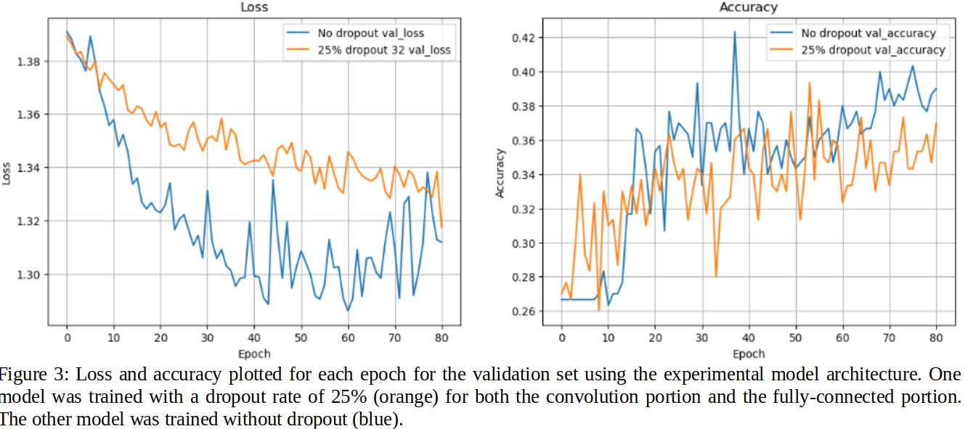
Training Results (continued)
Dropout
 | No dropout |  | 25% dropout
 | Val_loss | Val_acc | Val_loss | Val_acc
Average | 1.32 | 0.35 | 1.35 | 0.33
Notes:
The same does not hold true for dropout however, since the summary table does not tell the whole story. While it’s true that the architecture that did not employ dropout had a lower average validation loss and a higher average validation accuracy, the graph shows that from about epoch 60 and onward, the validation loss may have started to trend upward. This upward trend would indicate overfitting, so ultimately, it appears that employing dropout layers with a drop rate of 25% yielded more meaningful results.

Slide 8
Results
Strengths
Limitations
Can read x-rays
Appears as though the model could be improved upon
Does not express multi-dimensionality of data
Pays no attention to clinical implications of data/results
Notes:
So ultimately, yes, it appears as though it’s possible to train a model to some degree of accuracy to detect diseases from chest x-rays. Even an model built from scratch, without much optimization, using only 1500 images can attain 30-40% accuracy of 30-40%. That said, 30-40% is certainly not the degree of confidence required for deployment in a clinical setting. In truth, the problem is much more multi-faceted and nuanced than the experimental dataset alluded to, so there is a lot of room for improvement, which leads to poorer generalization. As such, the experimental model is severely limited in its ability to generalize to unseen illness, for example, and it’s performance on images of other size or formats remains as yet untested. Additionally, the model doesn’t account for the clinical side of the data, which is another avenue for future research. For example, one of the classes in the data set, infiltrations can have several causes and thus several treatments., so a machine-given diagnosis of ‘infiltration’, even to a high degree of accuracy, may have a relatively low clinical impact.

Slide 9
Conclusion
It can work, especially with improvements, but the proposed methodology fails to meet rigors of a clinical setting.
Please visit the Github for complete project details, as well as the associated project write-up: https://github.com/zachmichael14/data_mining_final
Notes:
So in conclusion, it can definitely work. While the proposed methodology possesses shortcomings with regard to deployment in a clinical setting, it shows great promise for future research. As previously stated, there is a lot of great work going on in this field and I suspect the fruits of that labor will have a real impact on patient outcomes in the very near future. For complete details on the project and the proposed methodology, please visit the project repository on Github, where you can also find the project report. That’s all from me, thank you for tuning in.

